Slide 1
7B
CHELSEA GIRLS

Slide 2
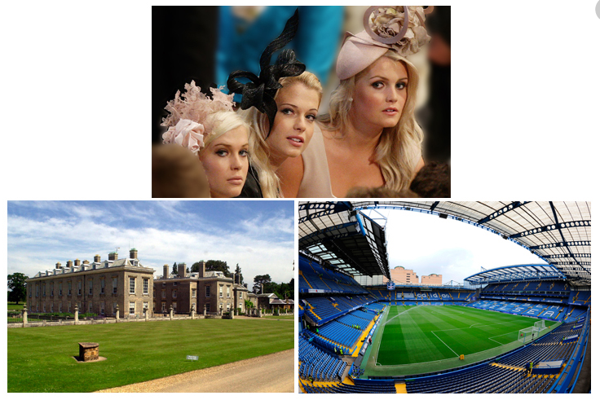



The Spencer sisters
Stamford Bridge Stadium
Althorp House

Slide 3
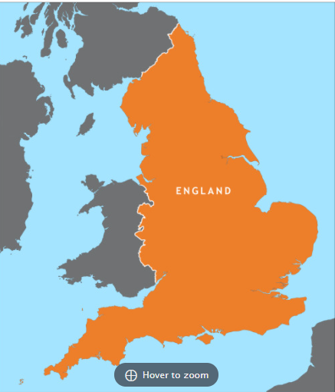
From ALTHORP to STANFORD BRIDGE IN YORKSHIRE: 146 miles (235 km)
STANFORD BRIDGE
ALTHORP
From ALTHORP to LONDON: 85 miles
(136 km)
LONDON

Slide 4

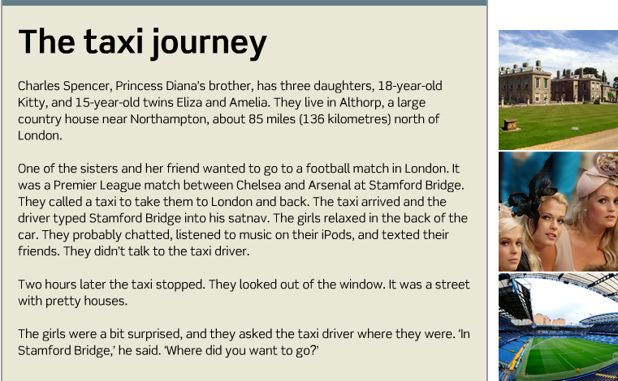

Slide 5
From ALTHORP to STANFORD BRIDGE IN YORKSHIRE: 146 miles (235 km)
STANFORD BRIDGE
ALTHORP
From ALTHORP to LONDON: 85 miles
(136 km)
LONDON

Slide 6
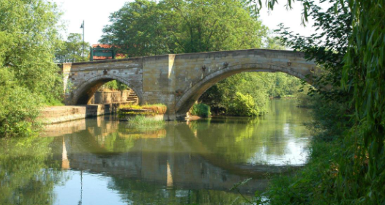
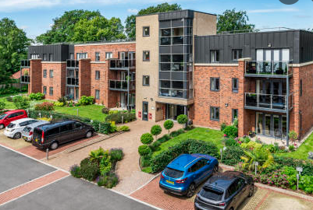

Slide 7
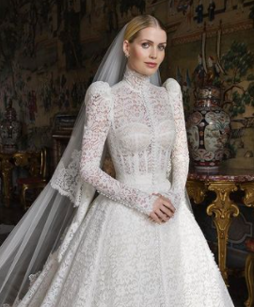
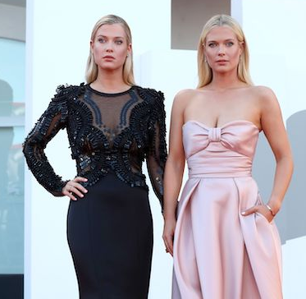
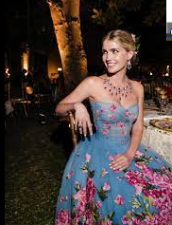

Slide 8
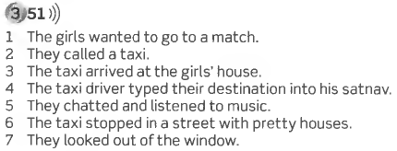
Page 54

Slide 9
-ed
/d/
/t/
/id/
 |  | wanted
called
arrived
 | typed
 |  | chatted
listened |  | texted
 | stopped
 | looked

Slide 10
wanted | match
called | taxi
arrived | the girl’s house
typed | satnav / GPS
chatted | Back / car
listened | music
stopped | street
looked | out/ window
The girls wanted to go to a match.
They called a taxi.
The taxi arrived at the girls’ house.
The taxi driver typed their destination into his satnav.
They chatted in the back of the car.
They listened to music in the car.
The taxi stopped in a street with pretty houses.
They looked out of the window.

Slide 11
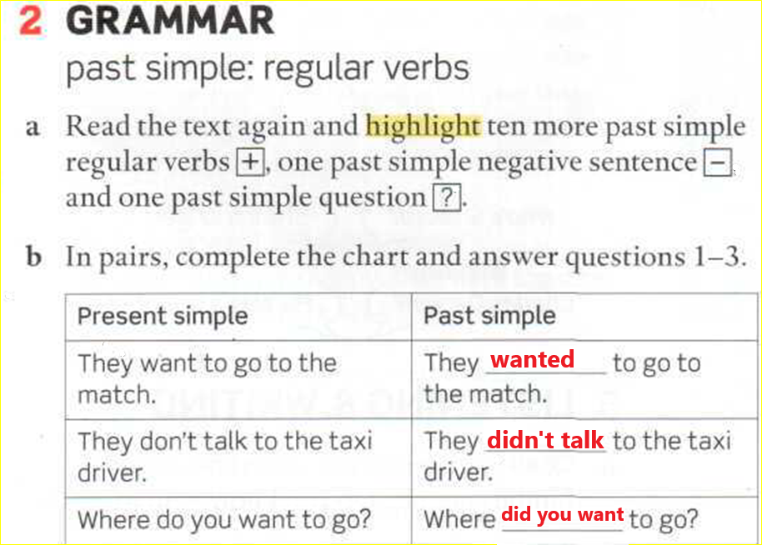
Page 54
DO/DOES
DID

Slide 12

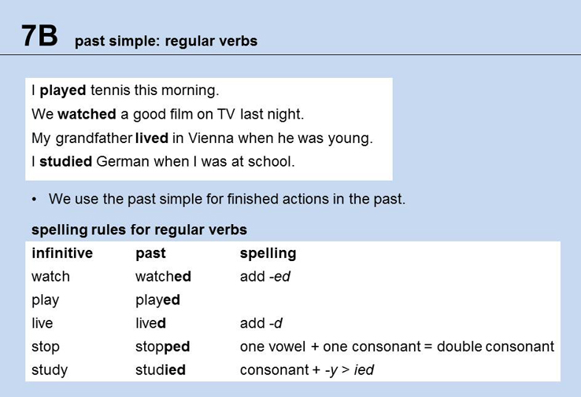
PAGE 136

Slide 13
I played tennis this morning
I didn’t play tennis this morning
Did you play tennis this morning?
Yes, I did
No, I didn’t
Did she play tennis this morning?
Yes, she did
No, she didn’t

Slide 14
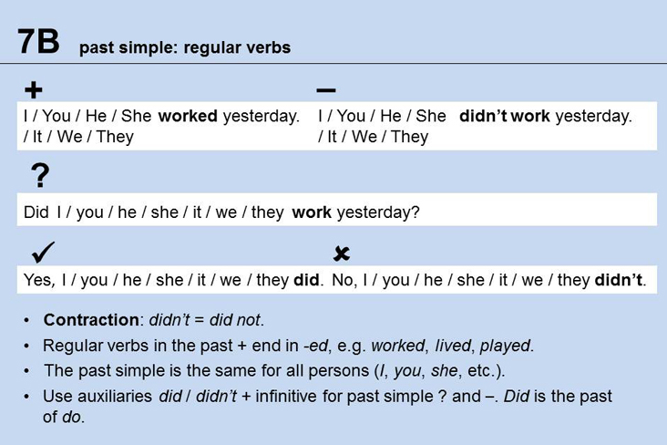

Slide 15
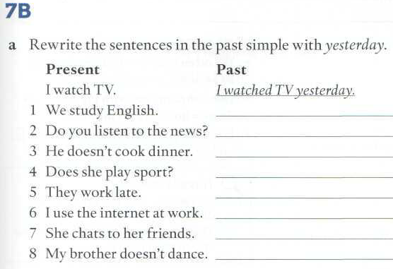

Slide 16
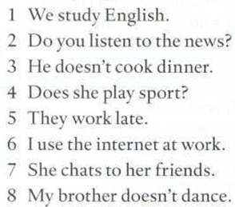
Page 137
1 We studied English yesterday.
2 Did you listen to the news yesterday?
3 He didn’t cook dinner yesterday.
4 Did she play sport yesterday?
5 They worked late yesterday.
6 I used the internet at work yesterday.
7 She chatted to her friends yesterday.
8 My brother didn’t dance yesterday.

Slide 17
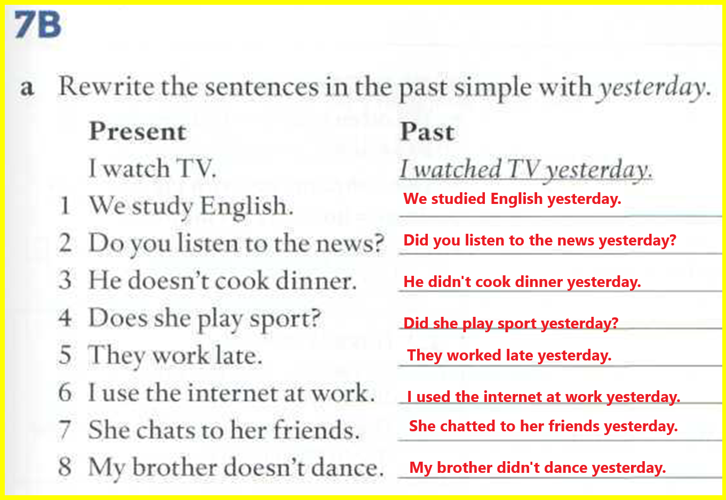

Slide 18
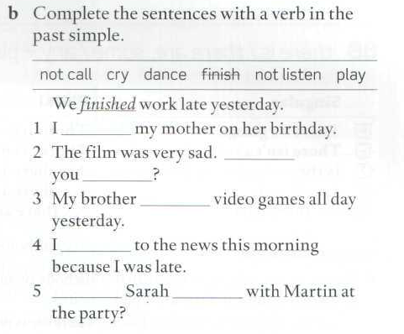
didn’ call
did
cry
played
didn’t listen
Did
dance

Slide 19
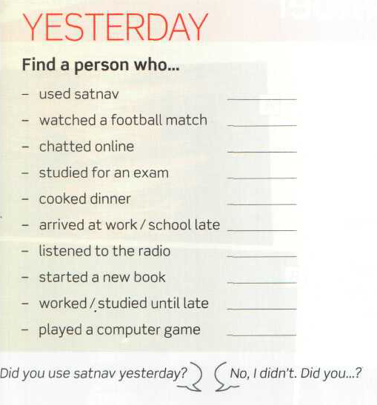
Affirmative
Negative
Question
Short answer

Slide 20
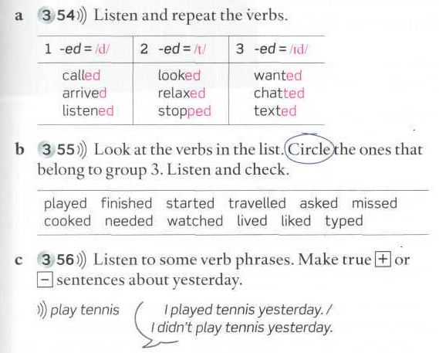

Slide 21
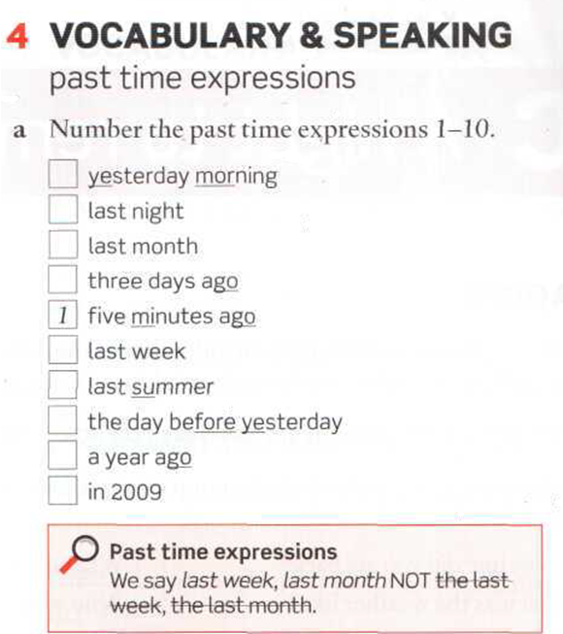
1 five minutes ago
2 last night
3 yesterday morning
4 the day before yesterday
5 three days ago
6 last week
7 last month
8 last summer
9 a year ago
10 in 2009

Slide 22
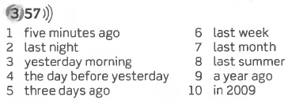

Slide 23
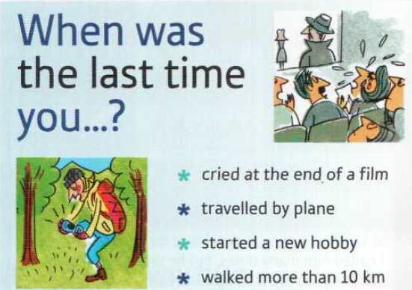
cry
travel

Slide 24
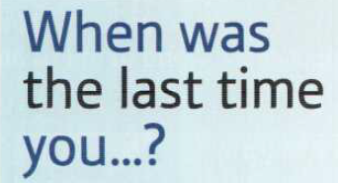
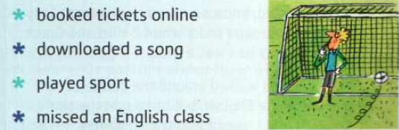

Slide 25
